Slide 1

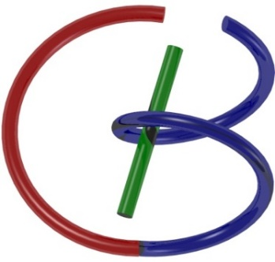
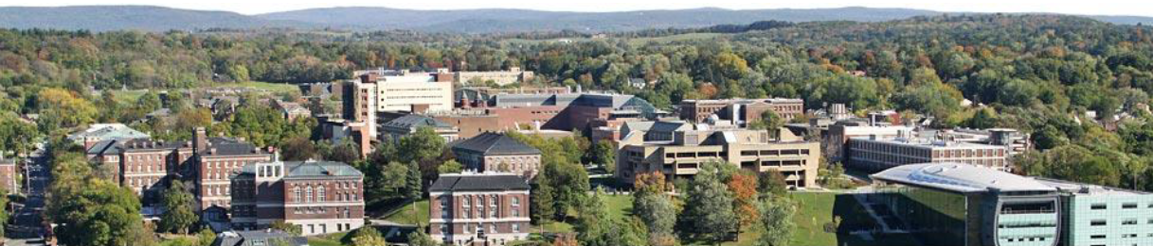
Ultrasound Imaging
Ge Wang
AI-based X-ray Imaging System (AXIS) Lab
Rensselaer Polytechnic Institute, Troy, New York, USA
November 12, 2021

Slide 2
MI Schedule for F21
Tue | Topic | Fri | Topic
08/31 | Introduction | 09/03 | Neuron, Network & Backpropagation
09/07 | No Class | 09/10 | Hands-on 1: Python, Colab, & TensorF
09/14 | Architectures & Training | 09/19 | Hands-on 2: MNIST Classification
09/21 | Image Quality I | 09/24 | CT Physics
09/28 | CT Reconstruction | 10/01 | Deep CT Reconstruction
10/05 | Hands-on 3: CT Networks | 10/08 | More CT Contents
10/12 | MRI Physics | 10/15 | Spin-Echo
10/19 | K-Space Theorem | 10/22 | More MRI Contents
10/26 | Mid Exam | 10/29 | Deep MRI Reconstruction
11/02 | Hands-on 4: MRI Networks | 11/05 | Nuclear Physics
11/09 | Nuclear Imaging | 11/12 | US Imaging
11/16 | Optical Imaging | 11/19 | Multimodality Imaging
11/23 | Hands-on 5: Image Conversion | 11/26 | Thanksgiving
11/30 | Image Quality II | 12/03 | Stability, Interpretability, & Others
12/07 | Overview | 12/10 | Final Exam
Office Hour: Teaching Day 5-6pm: https://rensselaer.webex.com/meet/wangg6

Slide 3
Outline
US Basics
– Wave Equation
– Transduction & Measurement
US & Tissue Interaction
– Huygens Principle
– Interaction Mechanisms
US Imaging Modes
– A, M, & B Modes
– Array Imaging
Doppler Imaging
– CW & PW
– Color
Image Quality
– Resolution
– Artifacts

Slide 4
Acoustic Wave Eq Made Easy
Time=t: Volumetric air element has a constant density ρ under a pressure gradient (horizontal)
Time=t+Δt: Volumetric air element is moved (horizontally)
We need to describe this local dynamics

Slide 5
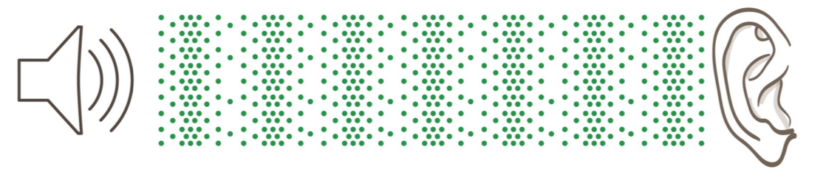
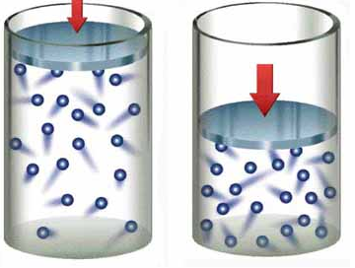
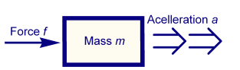
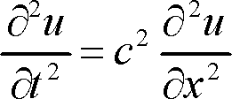
Acoustic Wave Eq Made Easy
Let us think p as the pressure change relative to the equilibrium pressure
Note that an alternative form of the wave equation can be expressed in terms of pressure p, instead of displacement h or u

Slide 6
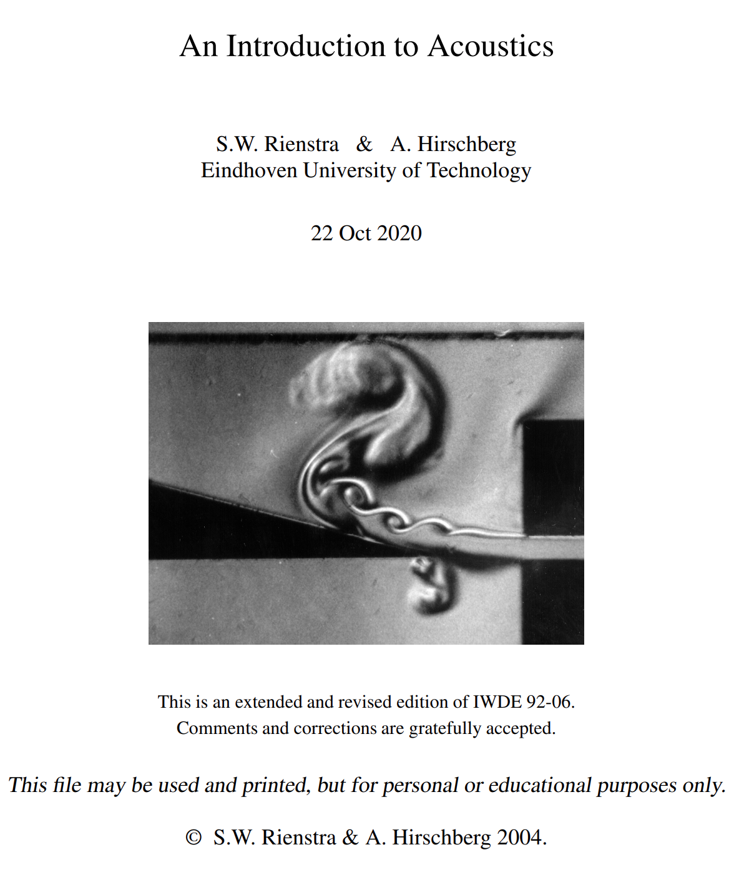
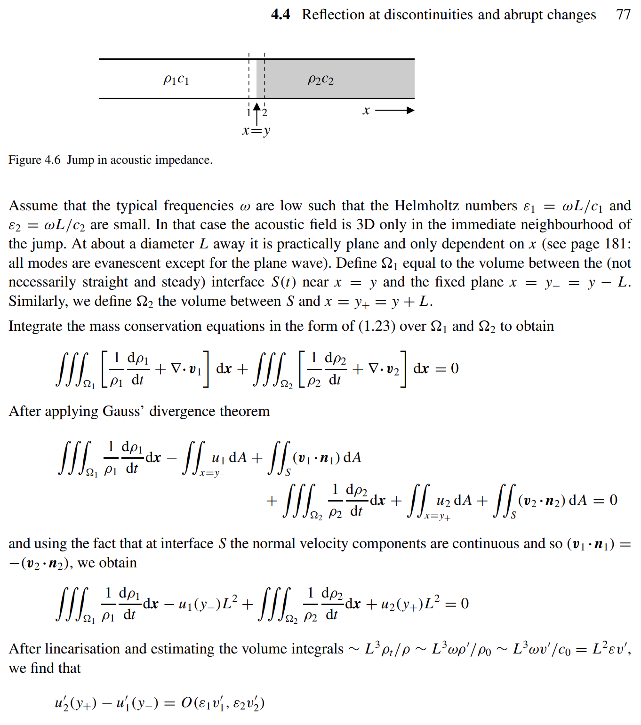
General Treatment Involved Other Factors
https://www.win.tue.nl/~sjoerdr/papers/boek.pdf

Slide 7
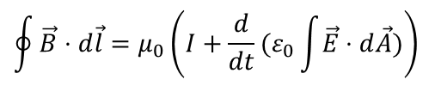
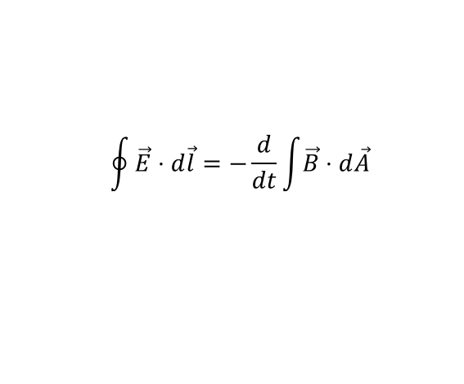
Maxwell's Equations
Gauss' Law for electricity
The total of the electric field over the surface of a volume equals the total charge inside
Gauss' Law for magnetism
No magnetic charge, i.e., no monopoles
Faraday's Law of magnetic induction
The left side is the total voltage change round a loop, and the right side is a varying magnetic field through the loop
Ampere's Law plus Maxwell's displacement current
The left side is the total magnetic force around a loop, and the right side is the current through the circuit, plus a varying electric field through the loop (displacement current)
$$\oint{\vec{E}⋅d\vec{l}=−\frac{d}{dt}}\int{\vec{B}⋅d\vec{A}}$$
$$\oint{\vec{B}⋅d\vec{l}=μ_{0}\left(I+\frac{d}{dt}(ε_{0}\int{\vec{E}⋅d\vec{A}})\right)}$$

Slide 8
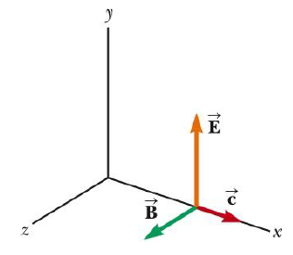
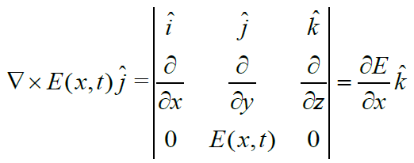
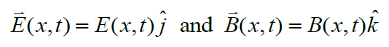
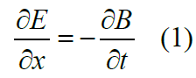
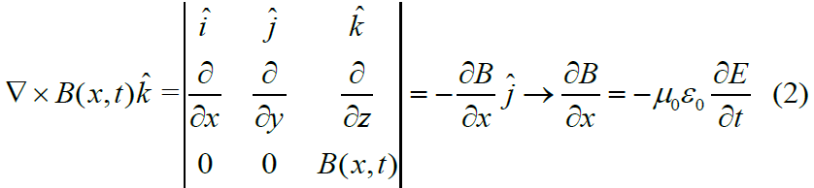
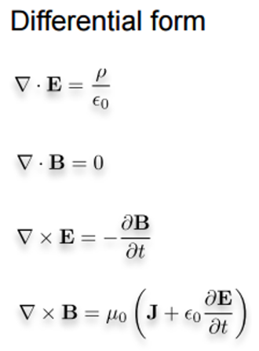
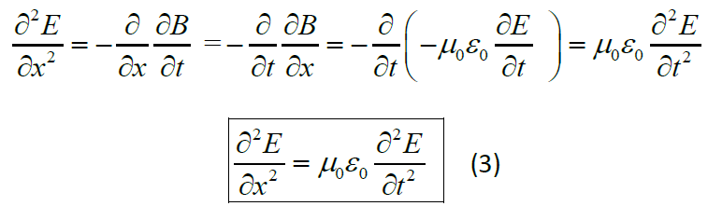
EM Wave Equation Made Easy
www.santarosa.edu/~lwillia2/42/WaveEquationDerivation.pdf

Slide 9
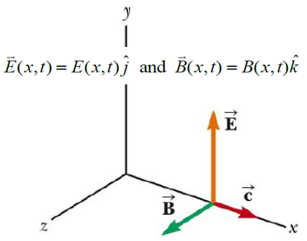
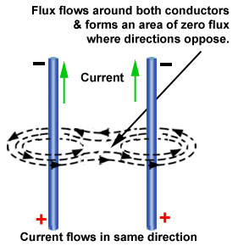
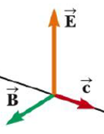
Why B Orthogonal to E & X Axes?
(0) Start with this simple case (Just consider the y component here without loss of generality)
(1) E Fields identical on the parallel planes
(2) B components along X axis must be zero!
(3) B curl must be due to components orthogonal to E & X axis
Eq. (4)

Slide 10
Linear wave equation
Assume small amplitude (small p) and nonviscous medium
general solution
Example of a solution (plane progressive wave) (x = direction of wave propagation)

Slide 11
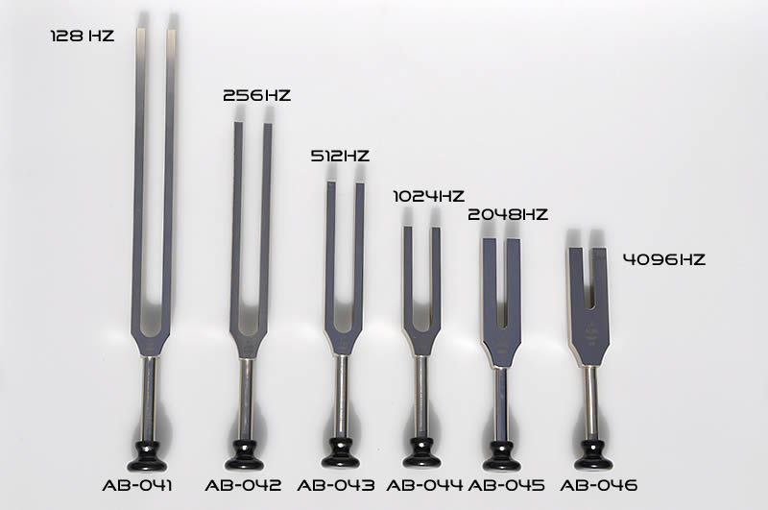
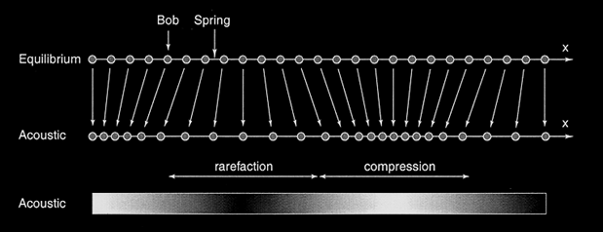
Physical Principles
What are ultrasonic waves?
elasticity and inertia of medium
-> displacements (compression and rarefaction) in the direction of wave motion -> longitudinal compression waves (> 20 kHz)

Slide 12
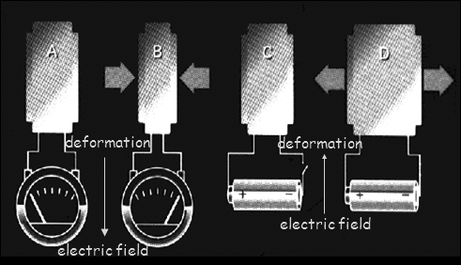
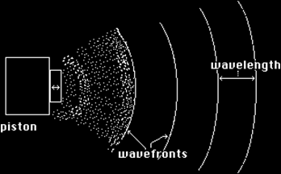
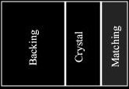
Generation of Ultrasonic Waves
piezo-electric crystal
deforms under influence of electric field
induces electric field under influence of deformation
ultrasonic transducer generation :
piezo-electric crystal + electric field -> deformation
detection :
piezo-electric crystal + deformation -> electric field
compression wave
compression wave

Slide 13
Outline
US Basics
– Wave Equation
– Transduction & Measurement
US & Tissue Interaction
– Huygens Principle
– Interaction Mechanisms
US Imaging Modes
– A, M, & B Modes
– Array Imaging
Doppler Imaging
– CW & PW
– Color
Image Quality
– Resolution
– Artifacts

Slide 14
Wave propagation in inhomogeneous media
Huygens' principle
The principle that any point on a wave front of sound may be regarded as the source of secondary waves and that the surface that is tangent to the secondary waves can be used to determine the future position of the wave front.

Slide 15
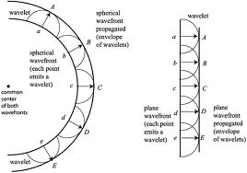

Slide 16
Interference between waves
for a large number of coherent point sources (i.e., with same frequency and phase) the complex interference pattern is called diffraction
example: 2 (or more) waves can amplify (constructive interference) or decrease (destructive interference) each other -> positions with constructive and positions with destructive interference
P
O₁
coherent
constructive
O₂
δ
destructive

Slide 17
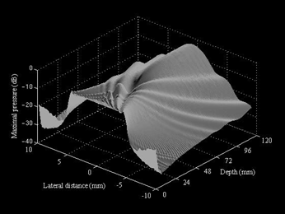
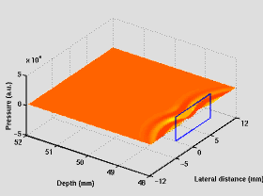
shape is related to the geometry of the acoustic source
circular planar source
rectangular planar source
far field -> constructive interference
near field

Slide 18
Specular reflection and refraction at smooth tissue boundaries
Reflection
Refraction
θ_{i}
θ_{r}
I_{r}
I_{i}
c₁
c₁ = λ₁.f
1
2
3
4
c₂
c₂ = λ₂.f
in practice: no perfect specularity
-> significant reflection in cone around θ_{r}
θ_{i}
I_{i}
c₁
c₁ = λ₁.f
c₁>c₂
1
2
3
4
c₂
c₂ = λ₂.f
I_{t}
θ_{t}

Slide 19
Wave propagation in homogeneous media
Specific acoustic impedance of a homogeneous medium
p = acoustic pressure v = particle velocity
ρ = mass density c = acoustic wave velocity = λ.f = λ/T
Substance c (ms⁻¹) Z = ρ c (10⁶kg/m²s)
Air (25°) 346 0.000410
Fat 1450 1.38
Water (25°) 1493 1.48
Soft tissue 1540 1.63
Liver 1550 1.64
Blood (37°) 1570 1.67
Bone 4000 3.8 to 7.4
Aluminum 6320 17.0
air -> tissue -> bone: ρ c Z= ρ c

Slide 20
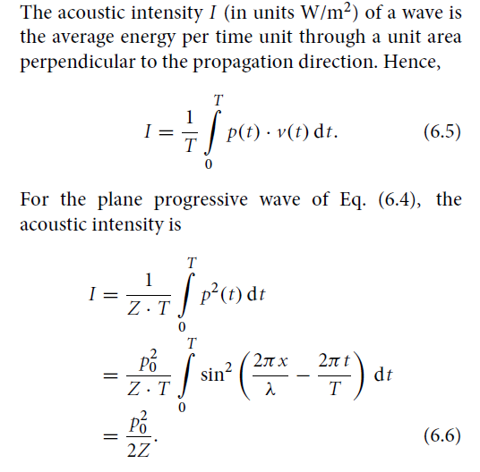
Acoustic Intensity

Slide 21
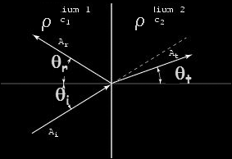
Snell’s law
Direction θ_{t} changes
Amplitude A (= p₀) changes as well (Intensity I ~ p₀²)
Transmission coefficient
Reflection coefficient (R = T–1)
reflected
wave
refracted
wave

Slide 22
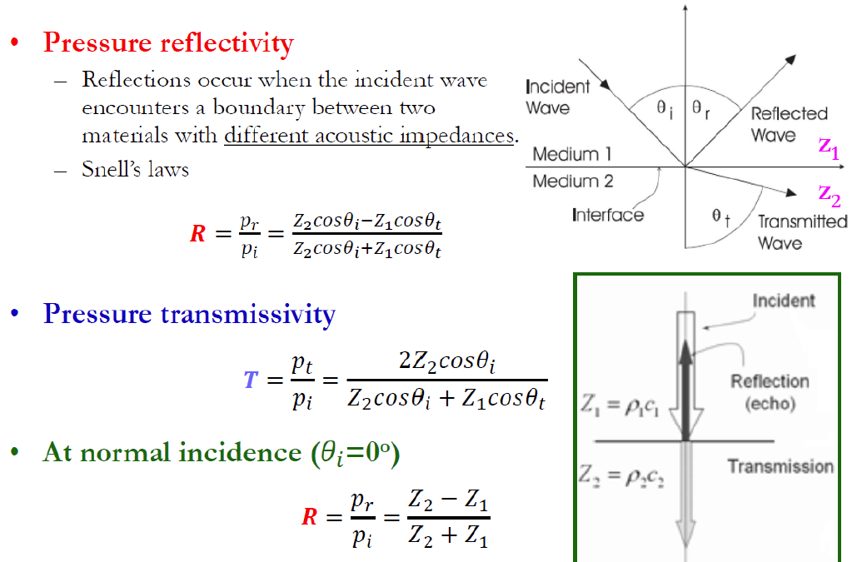
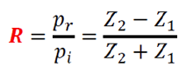
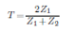
Reflection & Transmission
Z₂

Slide 23
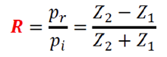
if Z₁ << Z₂ or Z₁ >> Z₂ -> large reflection
example:
Z_{bone} = ρ_{bone} . c_{bone} is large
Z_{air} = ρ_{air} . c_{air} ~ 0
at tissue/bone transition -> large reflection (50%)
at air/tissue transition -> total reflection (100%) -> use of gel

Slide 24
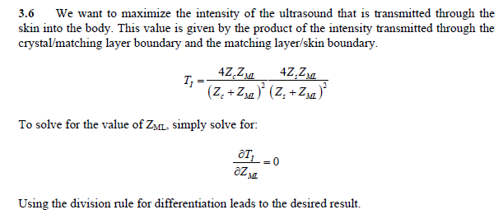
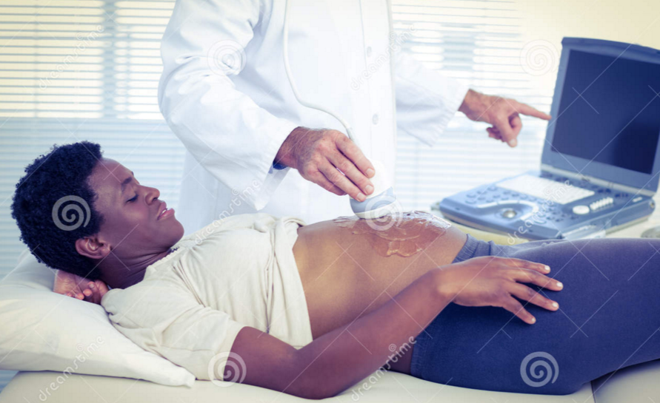

Why Matching Layer?
The intensity transmitted can be computed as 1-R² and
Z₂
The intensity transmitted can be computed as T²?

Slide 25
Acoustic intensity and loudness
Acoustic intensity I = average energy (J) per time unit (s) through unit area (m²) perpendicular to propagation direction (W/m²)
A tenfold increase in intensity I sounds a little more than twice as
loud to the human ear
-> to express the sound level L a logarithmic scale is used
(unit of L is decibel (dB))
I₀ = the threshold (at 1000 Hz) of human hearing (absolute silence) ~ 0 dB
example:
intensity I x 10 ~ sound level L: + 10 dB (and perceived loudness: x 2)
intensity I x 2 ~ sound level L: + 3 dB
70-80 dB (vacuum cleaner) -> memory and concentration problems > 80 dB (heavy traffic (80dB) rock concert (120 dB) jumbo (140dB) -> damage > 120 dB -> pain threshold
10⁻¹²

Slide 26
Attenuation
Loss of energy during propagation because of viscosity -> heat
α : attenuation coefficient
in Np/cm (Np = Neper (dimensionless) calculated as ln(p_{z}/p₀))
in dB/cm -> -> 1 Np = (20log₁₀(e)) dB = 8.6859 dB
α₀ = α/f
in Np/(cm.MHz) or dB/ /(cm.MHz)
example: α₀ = 0.5 dB/(cm.MHz) and f = 2 MHz -> amplitude/2 after 6 cm
n ~ 1 in medical imaging
z : propagation distance
f : frequency
Substance α₀ (dB / cm.MHz)
Lung 41 (α is large for air and bone)
Bone 20
Kidney 1.0
Liver 0.94
Fat 0.63
Blood 0.18
Brain 0.85
Water 0.0022

Slide 27
Smallest possible inhomogeneity = point scatterer -> retransmits incident wave in all directions (Huygens)
Finite scatterer = collection of point scatterers -> forms interference of constituting point scattering
diffraction pattern diffraction pattern
of small scatterer of large scatterer

Slide 28
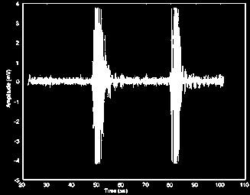
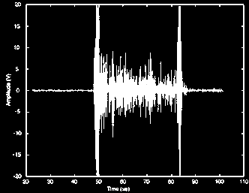
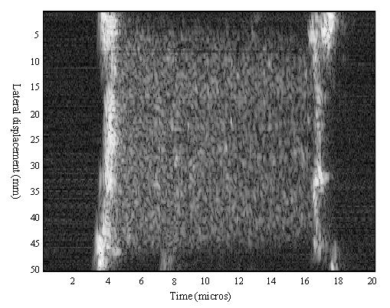
Scattering
homogeneous tissue inhomogeneous tissue
noise
scatter
specular reflection

Slide 29
Outline
US Basics
– Wave Equation
– Transduction & Measurement
US & Tissue Interaction
– Huygens Principle
– Interaction Mechanisms
US Imaging Modes
– A, M, & B Modes
– Array Imaging
Doppler Imaging
– CW & PW
– Color
Image Quality
– Resolution
– Artifacts

Slide 30

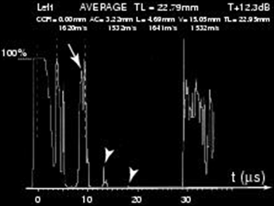
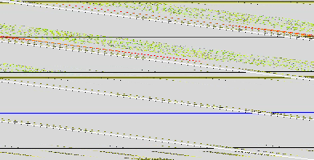
Gray scale Imaging
A mode (A = amplitude)
2 x distance = c x time
c for the different tissues

Slide 31
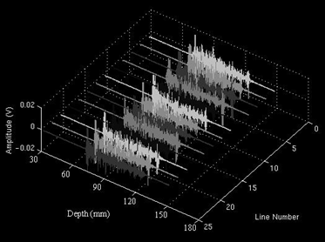
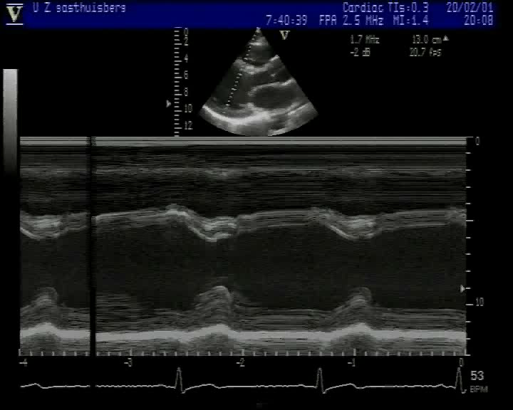
M mode (M = motion)
= repeated A mode -> gray scale image
time
distance

Slide 32
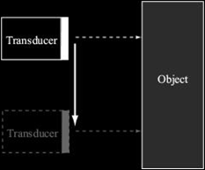
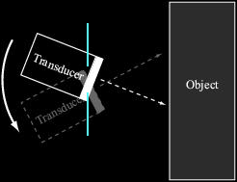
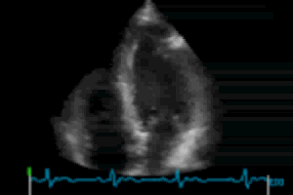
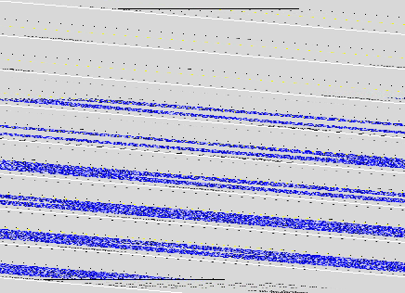
B mode (B = brightness)

Slide 33
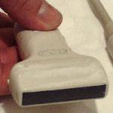
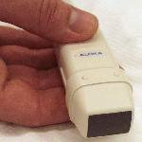
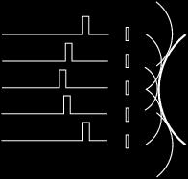

Phased Arrays
Artificial phase shift after reception
-> dynamic focusing
-> simultaneous scan lines -> temporal resolution (70 - 80 Hz)
Linear array transducer
= 1D array of crystals
Phased array transducer
Huygens'
principle
electronic focusing
electronic sweeping

Slide 34
Outline
US Basics
– Wave Equation
– Transduction & Measurement
US & Tissue Interaction
– Huygens Principle
– Interaction Mechanisms
US Imaging Modes
– A, M, & B Modes
– Array Imaging
Doppler Imaging
– CW & PW
– Color
Image Quality
– Resolution
– Artifacts

Slide 35


Slide 36


Slide 37



Pulse Front & Scatter Meet at t_{is}

Slide 38



Pulse End (λ) & Scatter Meet at t_{ie}

Slide 39


Echo Duration from Front to End

Slide 40


Doppler Frequency f_{D}

Slide 41
Outline
US Basics
– Wave Equation
– Transduction & Measurement
US & Tissue Interaction
– Huygens Principle
– Interaction Mechanisms
US Imaging Modes
– A, M, & B Modes
– Array Imaging
Doppler Imaging
– CW & PW
– Color
Image Quality
– Resolution
– Artifacts

Slide 42

Image Resolution

Slide 43


Image reconstruction
filtering
removes high frequency noise
removes low-freq. band in 2nd harmonic imaging
envelope detection
envelope ~ amplitude of the signal ~ gray value in the image

Slide 44


attenuation correction = time-gain compensation
simple model = exponential decay
different tissues ~ different attenuations -> most US scanners enable manual modification of the gain at different depths
log-compression = gray scale transformation
logarithmic function -> scatter (or speckle) is also visible
scan conversion = sector reconstruction
interpolation : polar grid -> rectangular grid

Slide 45
Acquisition and reconstruction time
example :
depth : 20 cm -> travel distance = 40 cm
c = 1540 m/s
1 image = 120 scan lines
acquisition time = 32 ms (reconstruction in real time)
~ 30 images per second (30 Hz)
Note :
current scanners acquire multiple scan lines simultaneously temporal resolution : 70 - 80 Hz
è
è
è

Slide 46




Artifacts
interference pattern contains side lobes
reverberations

Slide 47


Homework
Optional: If we use two matching layers, will the transmission efficiency be further improved?
Read the Ultrasound imaging chapter through, especially the materials not fully covered in the class such as pages on image quality and artifacts

